Slide 1
EOPSY Lab 5,6,7
Project Report
Maciej Domański, Krzysztof Rudnicki, Gabriel Skowron-Rodriguez

Slide 2
Minimum Viable Product functionality
Enemy base and ability to destroy it
Map tiles and soldiers occupying them
Exactly one type, squad and one formation of soldier
Soldier spawning
Soldier attributes
Soldiers communication
Soldier Attack
Player orders
Enemy

Slide 3
Functionality that was needed to fulfill MVP
Movement
Player Interaction
Tick System
Various managers in Unity

Slide 4
Pure Additional Functionality
Ally/Enemy text above soldiers (Better Visibility)
Tile Sprites (Better Visibility)
Different Map Sizes
Entity class (Code quality)

Slide 5
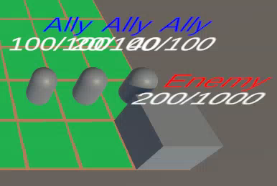
Enemy base and ability to destroy it
Base is defined in Base.cs and is exactly the same as Entity.cs, base can be destroyed

Slide 6
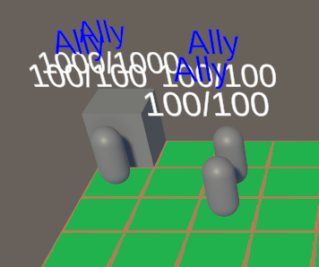
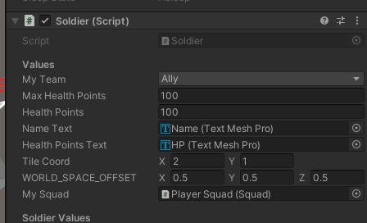
Map tiles and soldiers occupying them

Slide 7
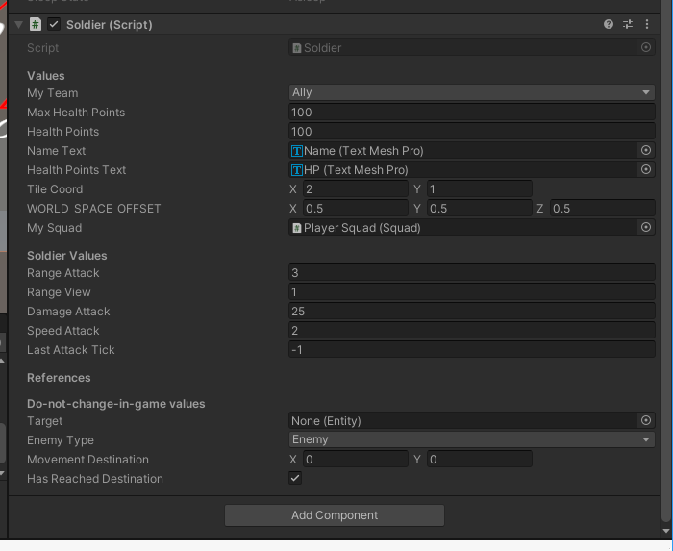
One type of soldier
There is exactly one type of soldier defined in soldier.cs

Slide 8
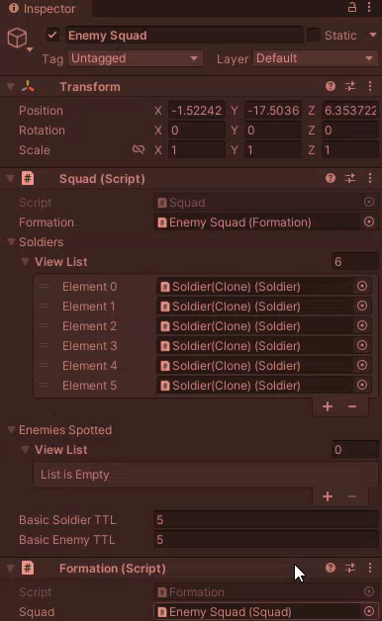
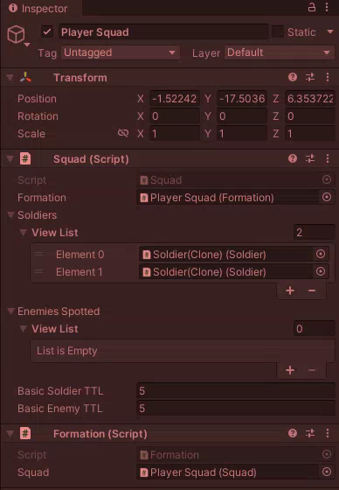
One squad
There is exactly one squad per Team, its functionality is defined in Squad.cs

Slide 9
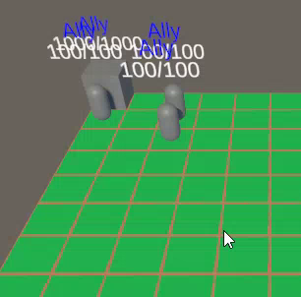
One soldier formation
There is exactly one formation defined in Formation.cs (we went for line formation)

Slide 10
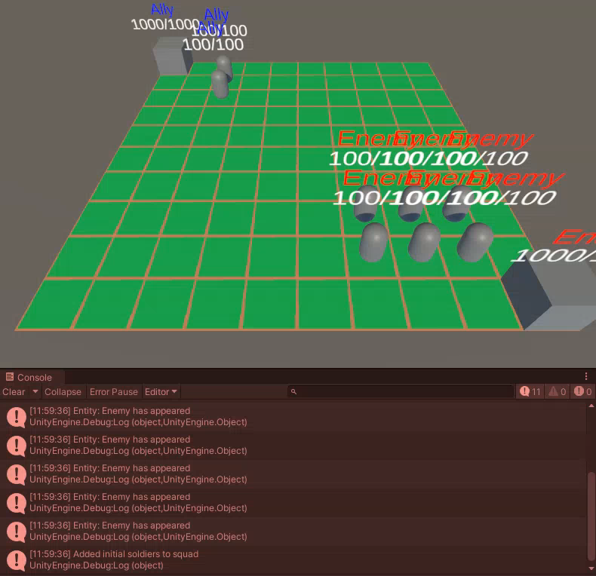
Soldier spawning

Slide 11
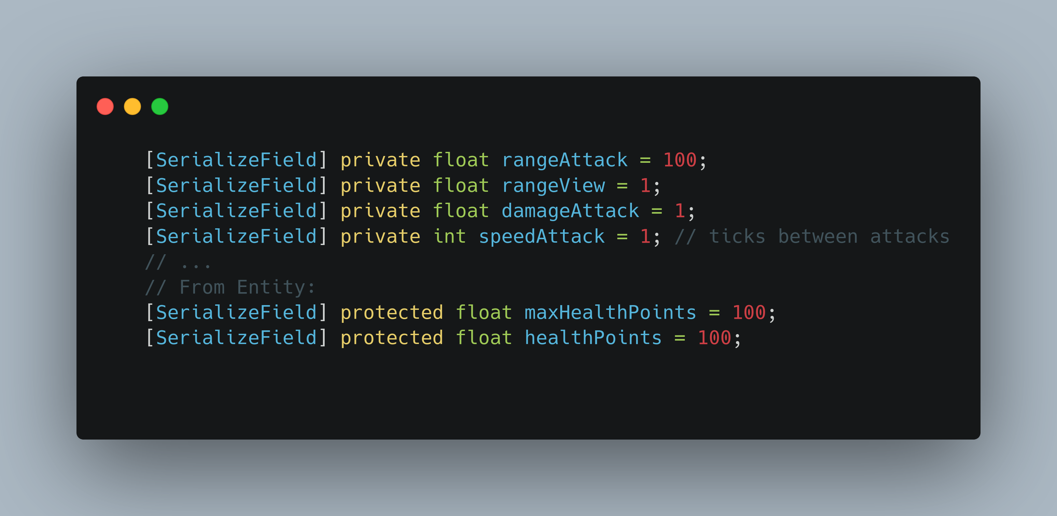
Soldier attributes

Slide 12
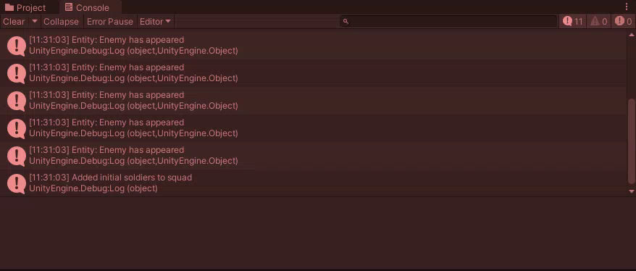
Soldier Communication
Soldiers can communicate with each other through different messages like e.g.: if they give/receive damage; soldier is added to squad; soldier is lost from squad due to TTL (Time To Leave)

Slide 13
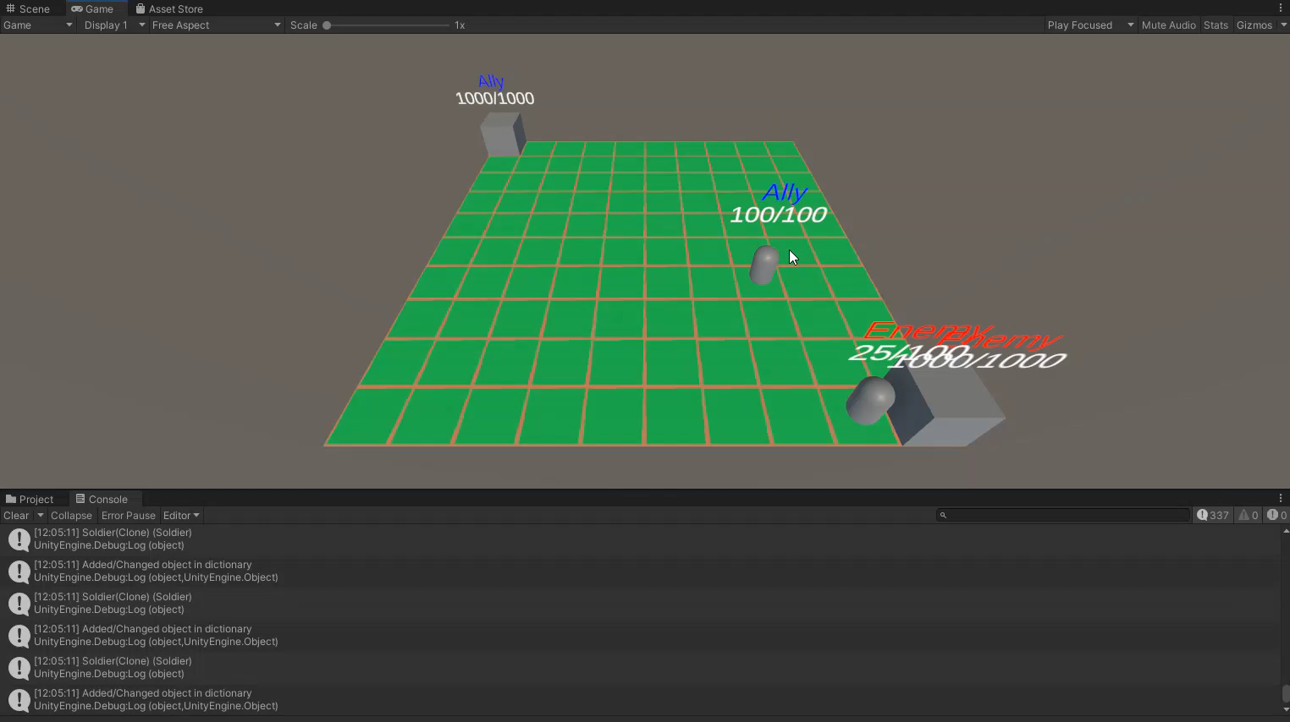
Soldier attack
When not performing any tasks, soldiers attack the closest enemy within range (here attack range == 3)

Slide 14
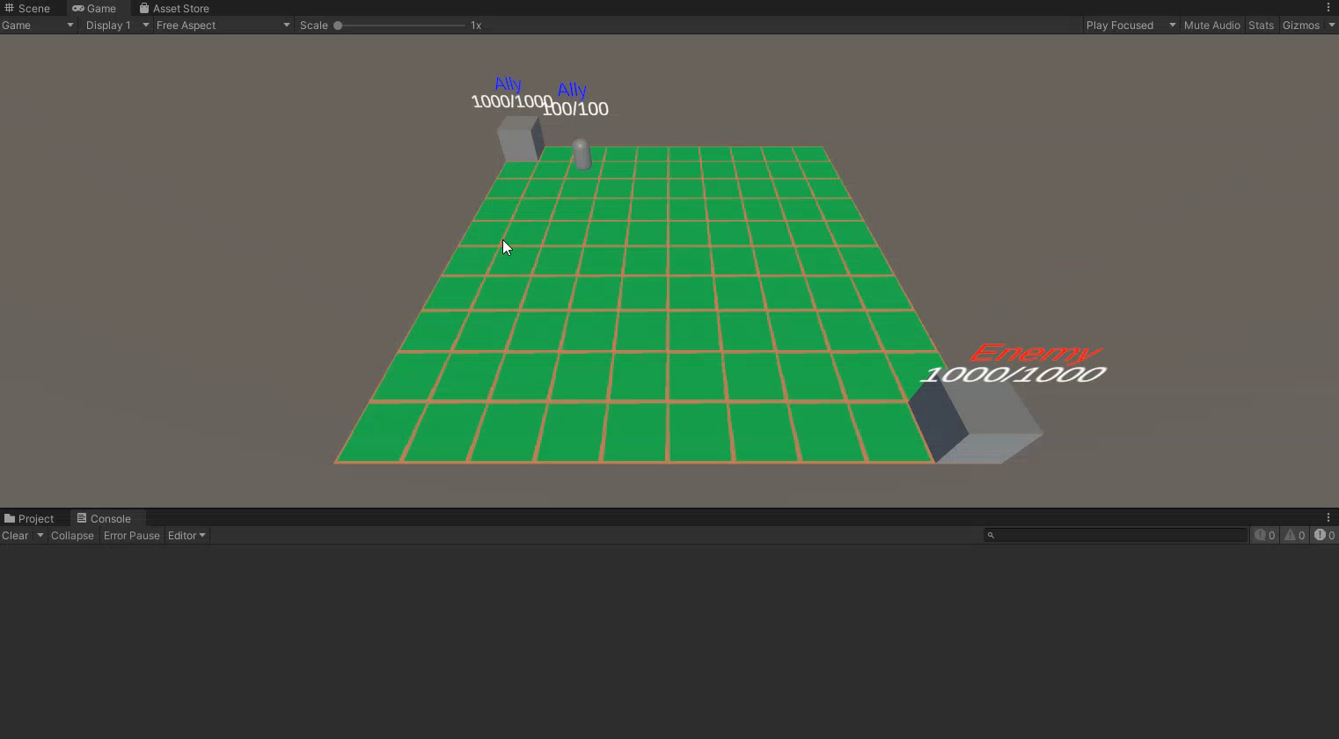
Player orders
Player orders movement to the whole squad, the squad passes them down onto individual soldiers who execute them on their own

Slide 15
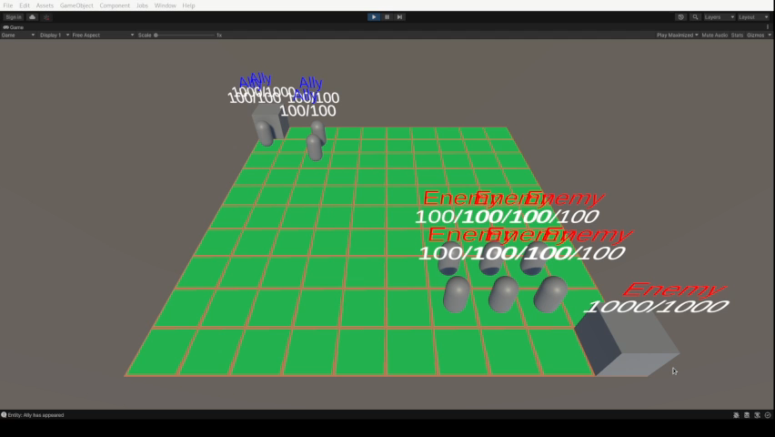
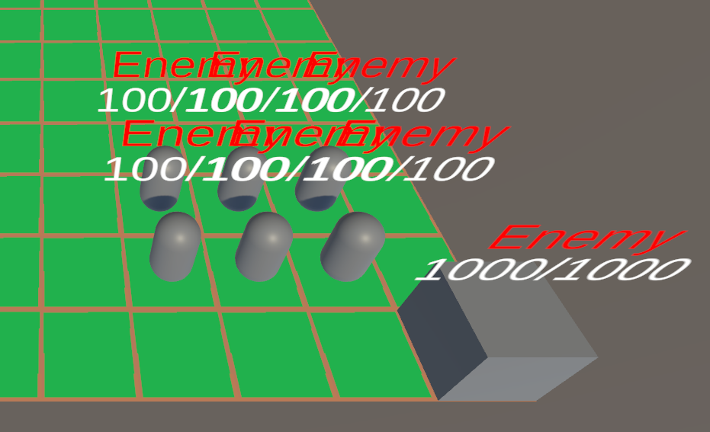
Enemy

Slide 16

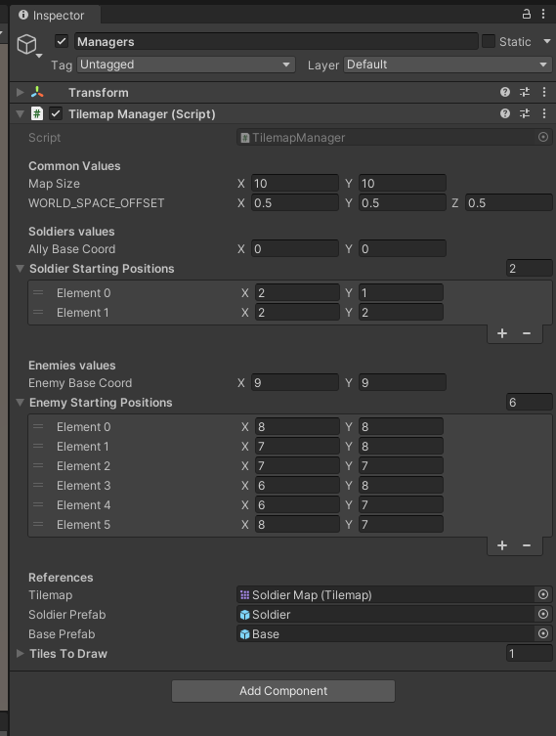
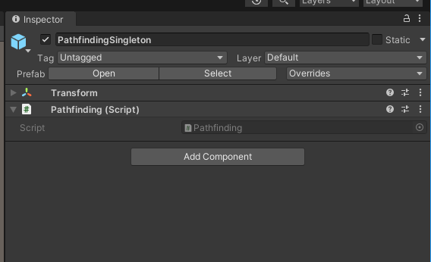
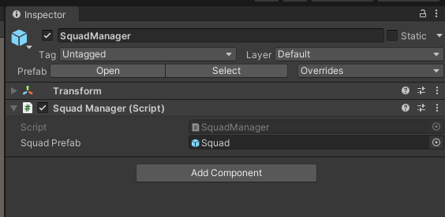
Various Managers

Slide 17
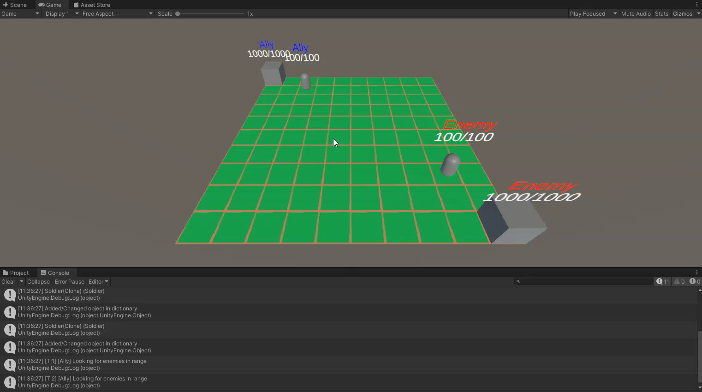
Tick System
Soldiers perform a single action (movement, attack) per tick.
Player commands can be scheduled at any time, soldiers adjust to orders when ticked.

Slide 18
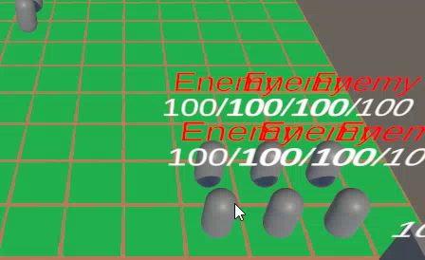
Player Interrupt
Player interrupts have the highest priority, so when constantly clicking (interrupting) we prevent soldiers from attacking

Slide 19
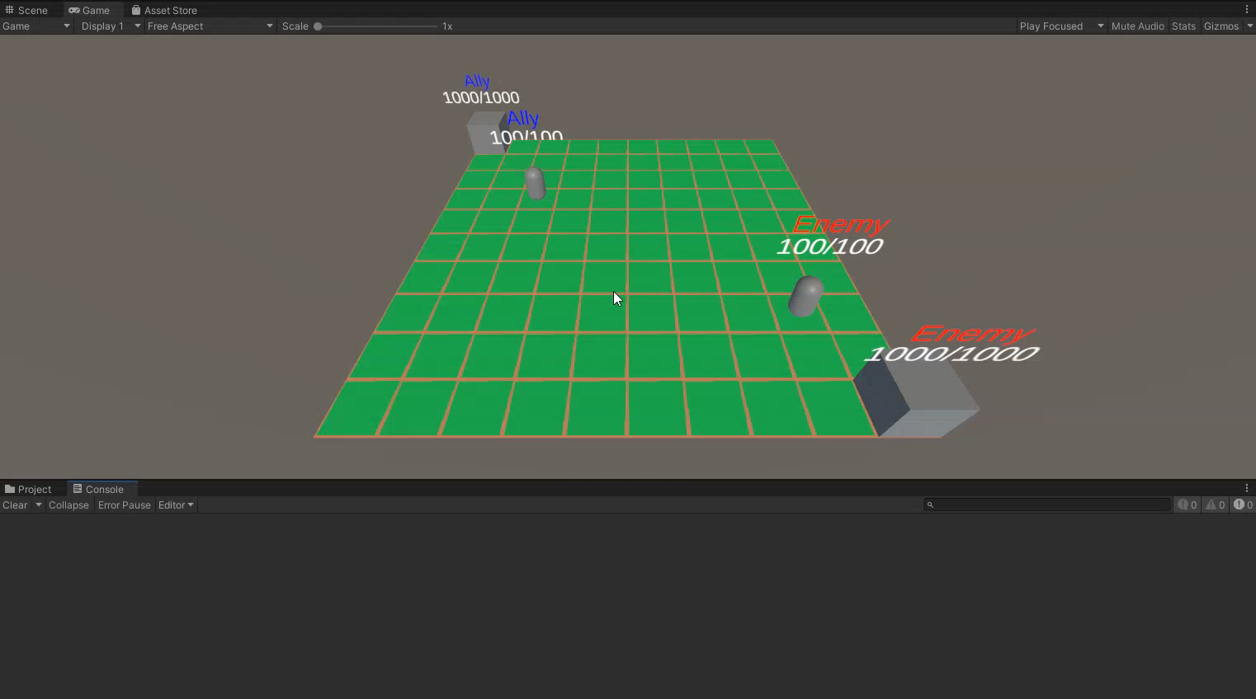
Movement
When not in target position, soldiers move towards their destination.

Slide 20
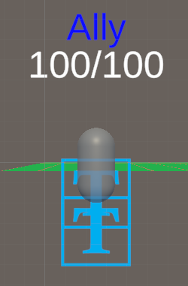
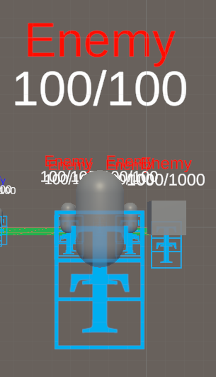
Ally/enemy text above soldiers

Slide 21

Tile sprites
We use a simple image to differentiate between the individual tiles, presented below:

Slide 22
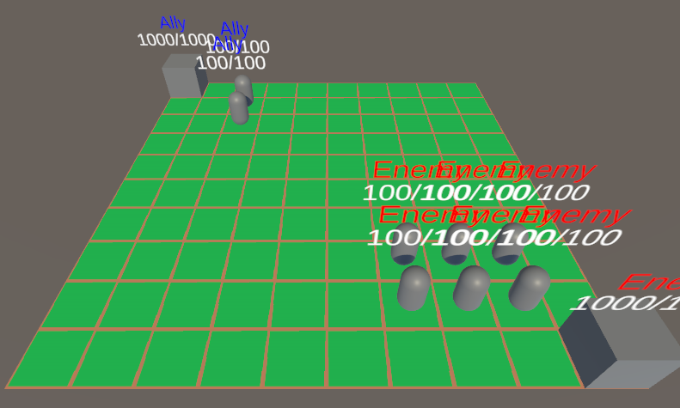
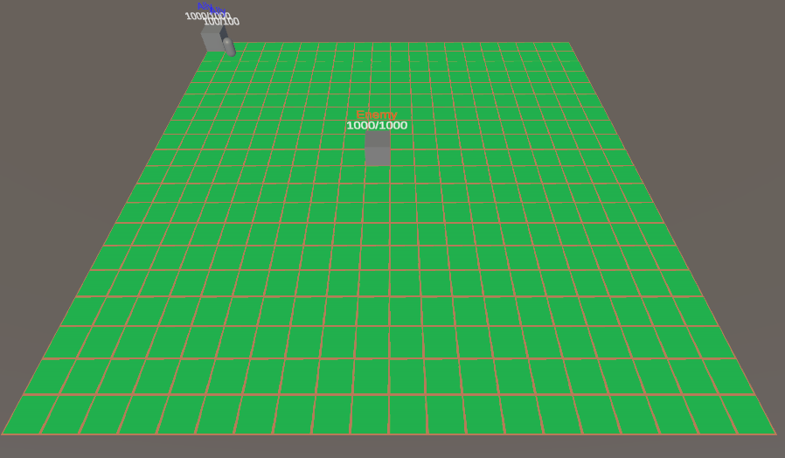
Different Map Sizes
Different map sizes can be set to change the scale of the simulation

Slide 23
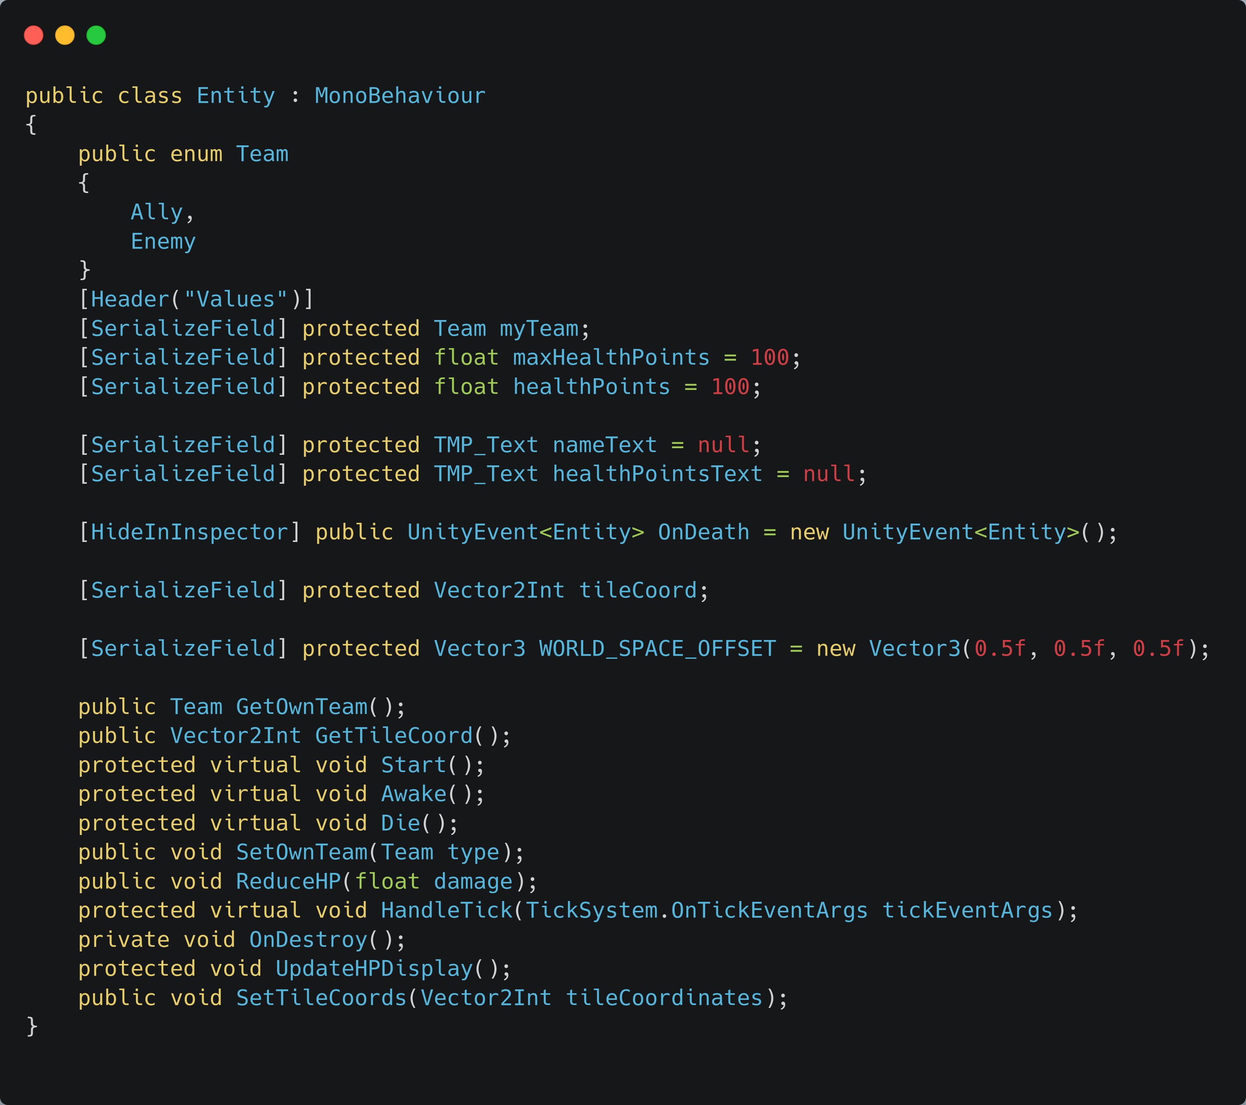
Entity class
Used as a parent of Soldier and Base class, contains functionality for health losing, getting tile cords, setting team. In Entity.cs

